Slide 1
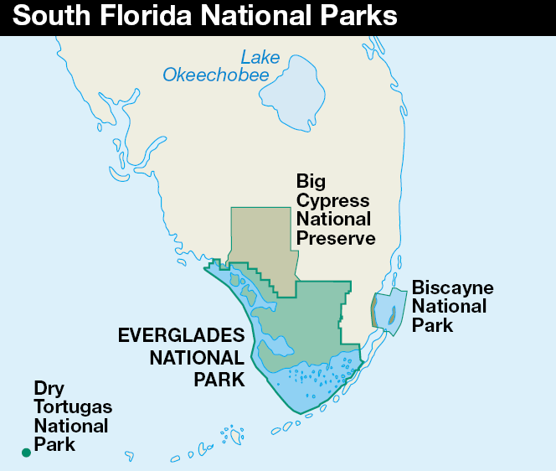
Notes:
In this lesson we will start our examination of divergent continental margins by looking at a modern example – the South Florida National Parks. Our study will focus on the Everglades, but Biscayne and Dry Tortugas National Parks will also contribute to our understanding. An important goal here is to understand the depositional processes that have built this modern divergent continental margin so that the formation of ancient DCM’s, as are preserved in the Grand Canyon, will be make more sense.

Slide 2
Notes:
I have to admit that I was skeptical about presenting a lesson on south Florida’s geology, because frankly I didn’t think it had any. After all, this is apparently some of Florida’s “best rock” for climbing! Kind of like surfing in Oklahoma I suppose.

Slide 3
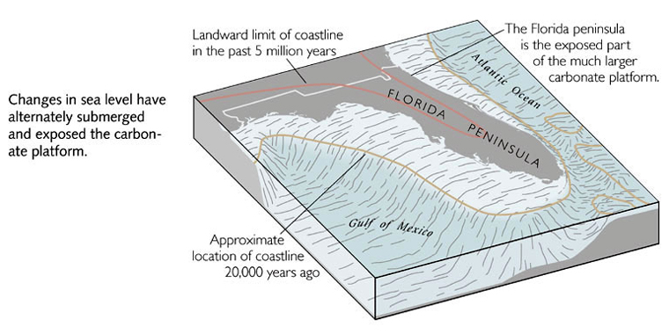
Notes:
Anyway, it turns out that the nation’s most topographically-challenged state has some surprisingly important geologic principles to teach precisely because it is so flat. You see, when sea level changes on such landscapes, shorelines and corresponding depositional patterns shift tremendously. Florida is a carbonate platform that has been alternately exposed and almost completely covered by low and high sea level stands respectively.

Slide 4
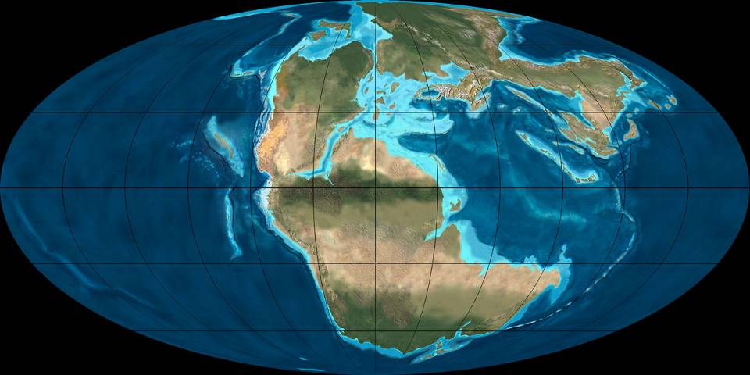
200
Notes:
The peninsula’s status as a carbonate platform starts some 200 million years ago when Pangaea first underwent rifting. Note that Florida will form on the southeastern corner of North America in the little nook between South America and Africa.

Slide 5
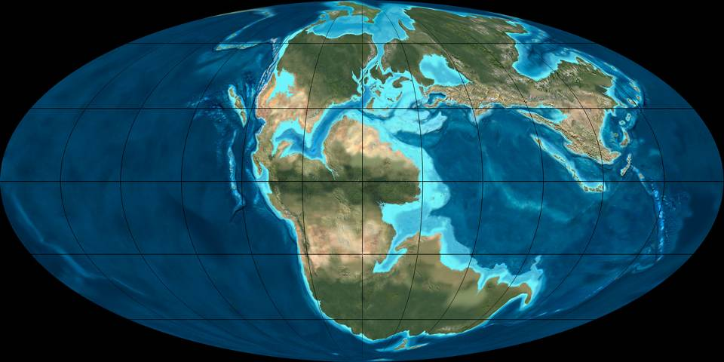
170
Notes:
As rifting progressed, the associated global rise in sea level combined with the tropical climate to produce the perfect conditions for reef growth and the formation of carbonates in ancestral Florida.

Slide 6
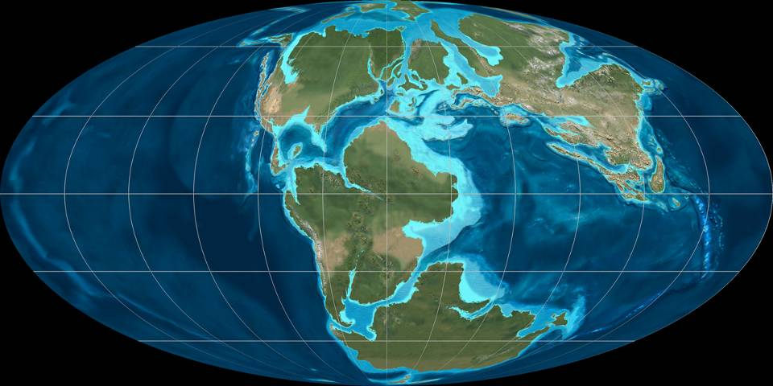
150
Notes:
Because ancestral Florida stayed in the tropics following the break-up of Pangaea, …

Slide 7
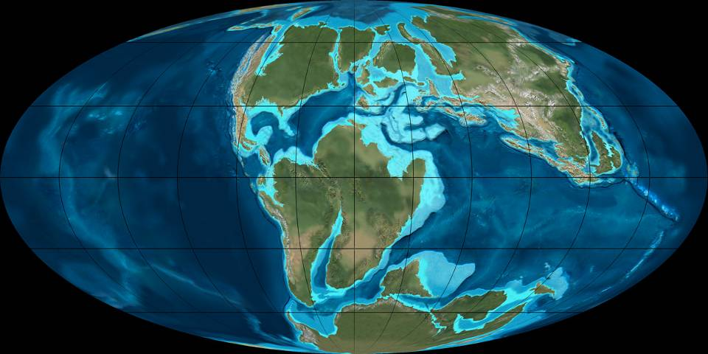
120
Notes:
… reef growth continued largely uninterrupted throughout the Mesozoic, …

Slide 8
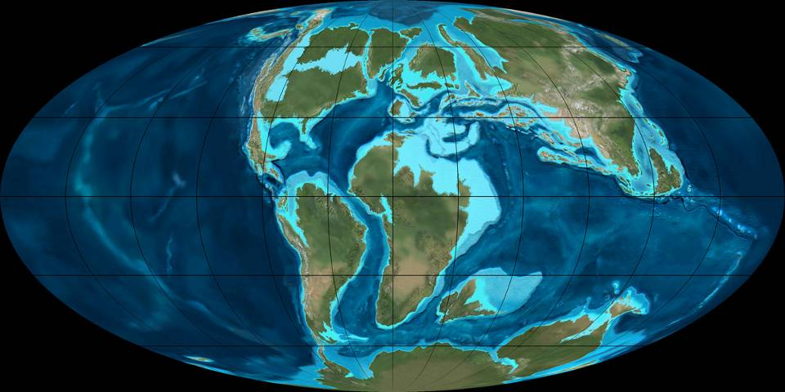
105

Slide 9
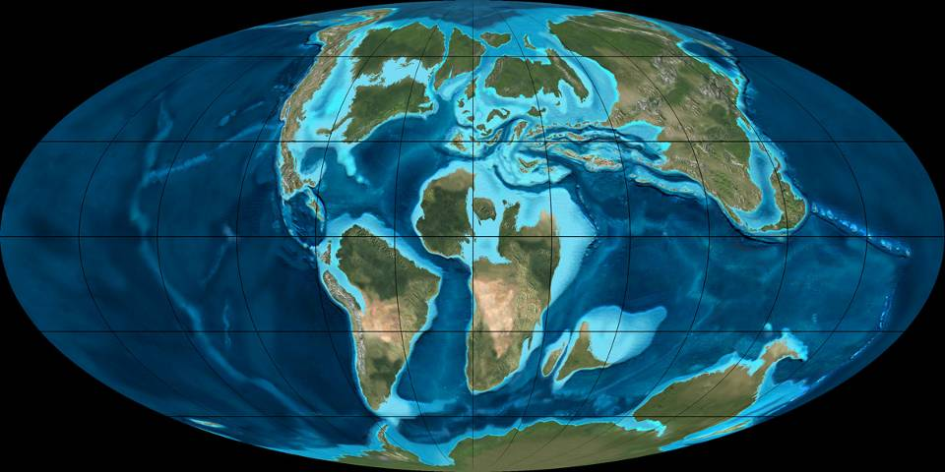
90

Slide 10
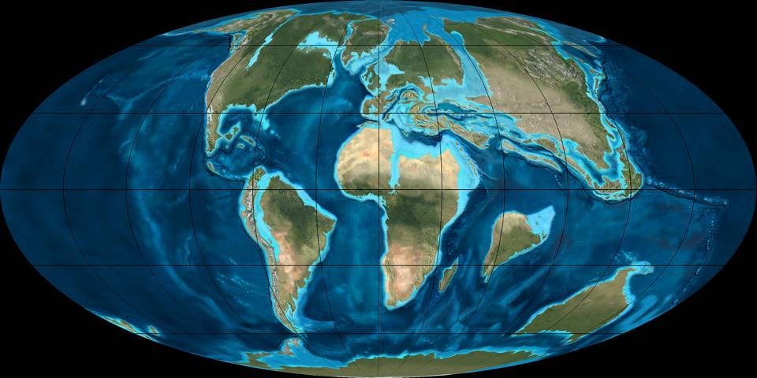
65
Notes:
… and Cenozoic …

Slide 11
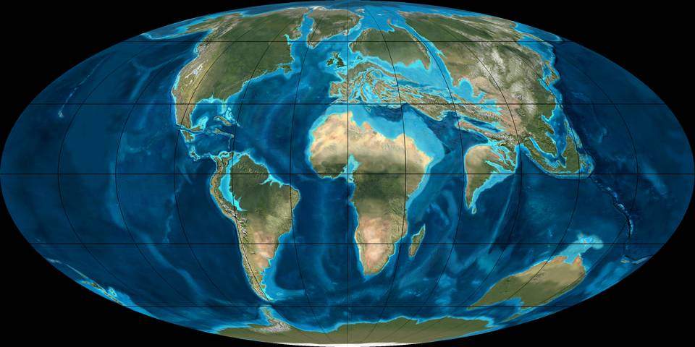
50

Slide 12
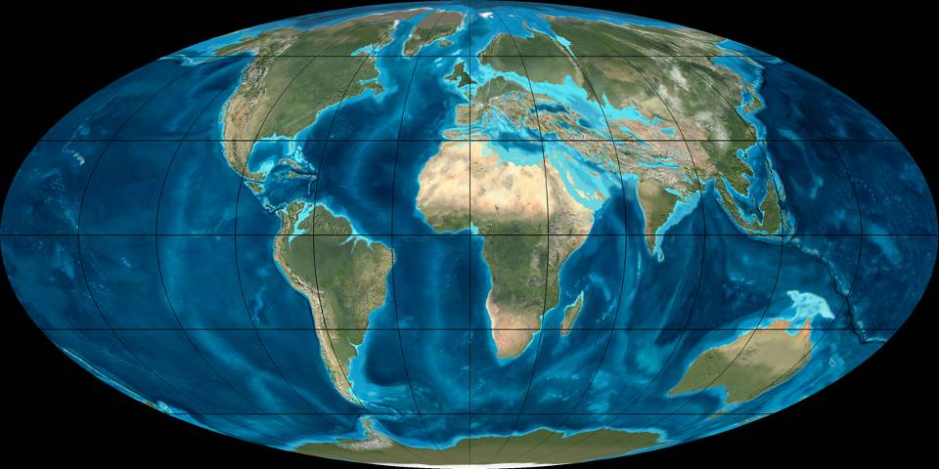
35

Slide 13
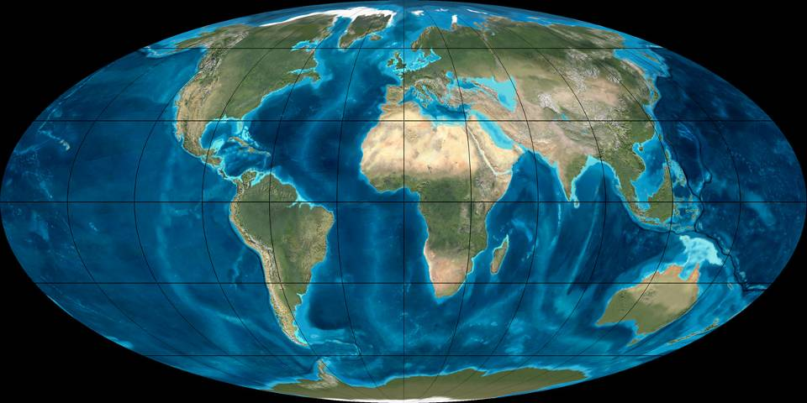
20

Slide 14
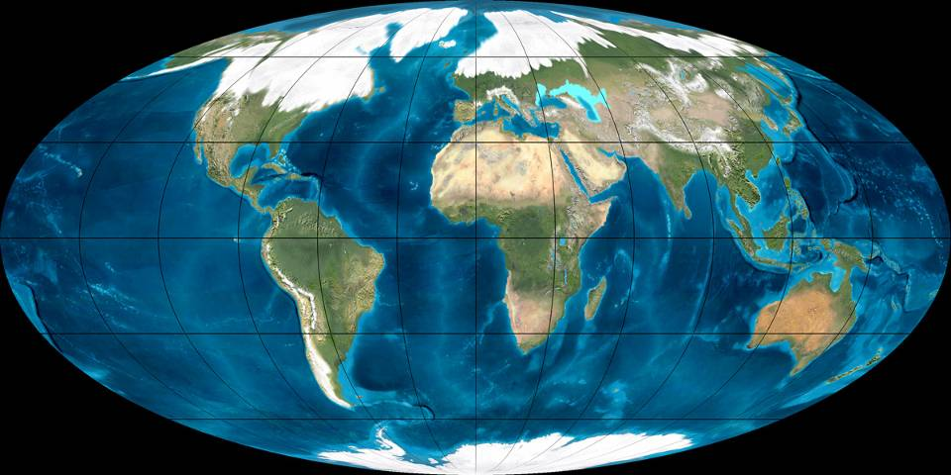
Pleistocene
Notes:
… until the Pleistocene glacial episodes intermittently interrupted reef growth during intervals when sea levels dropped due to sea water being bound-up as glacial ice.

Slide 15
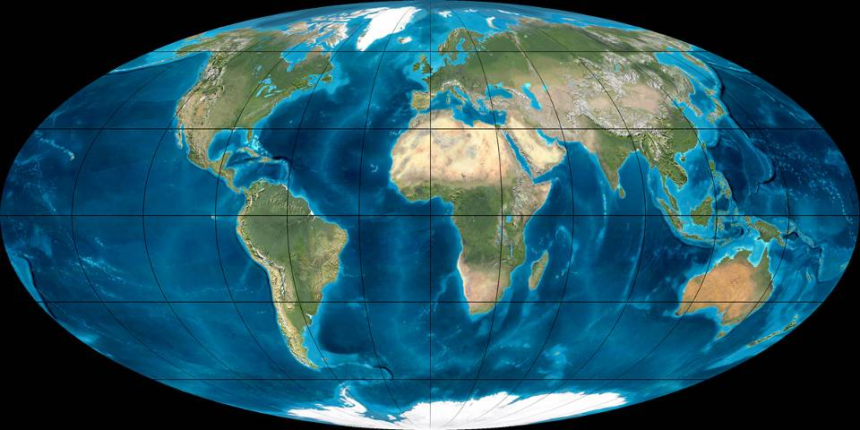
Present
Notes:
The present interglacial period has risen sea level and promoted reef growth.

Slide 16
Notes:
It’s important to keep in mind that sea level has been both higher and lower than the present level.

Slide 17
Pleistocene deposition:
120,000 y.a. 20’+ sea level
Key Largo Limestone
Miami Limestone
Notes:
We will focus on carbonate deposition during the Holocene and the later part of the Pleistocene. During a particularly warm interglacial period 120,000 years ago, global sea levels where 20 feet higher than today. That promoted the deposition of two major south Florida carbonate units – the Key Largo and Miami Limestones.

Slide 18
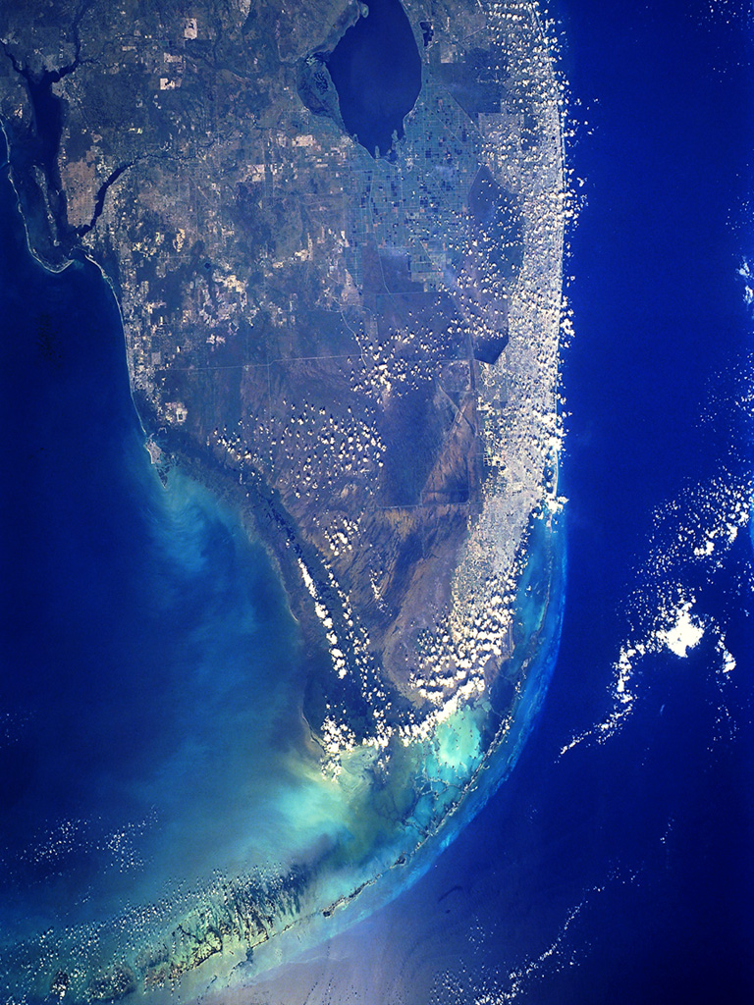
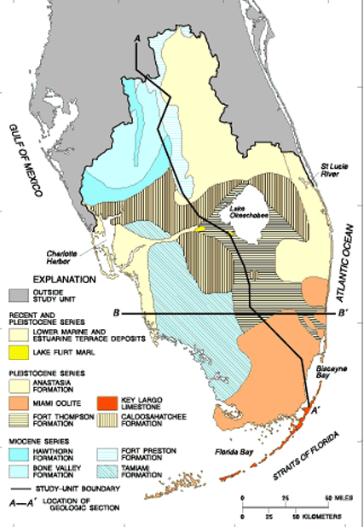
Key Largo Limestone
Key Largo Limestone
Notes:
Most of the Florida Keys are made of Key Largo Limestone.

Slide 19
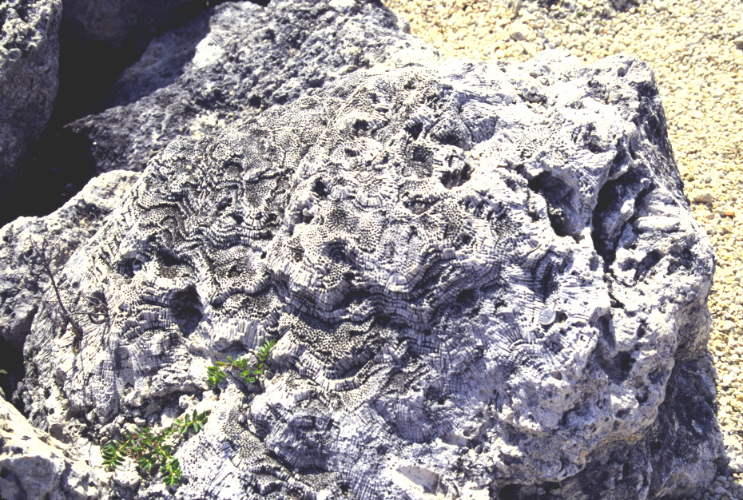
Key Largo Limestone
Notes:
… which contains abundant coral fossils …

Slide 20
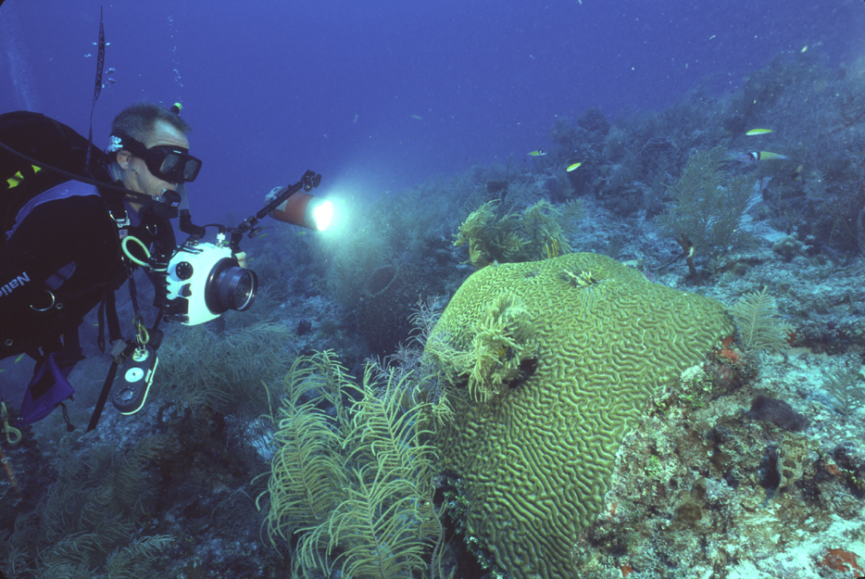
Patch reef Brain Coral
Notes:
… from patch reef builders like this brain coral. Patch reefs are small isolated reefs that grow between the main barrier reef and the shore.

Slide 21
Approximate shoreline
Notes:
The position of the shoreline 120,000 years ago is represented by the western edge of the Miami Limestone.

Slide 22
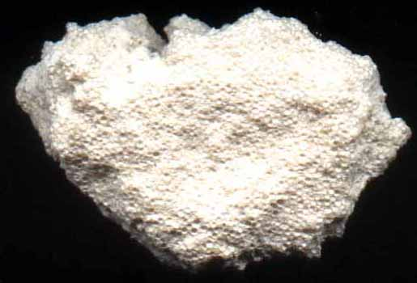
Miami Limestone (oolite facies)
Notes:
The Miami Limestone consists of two facies, one of which is oolitic. Oolites are much like pisolites only smaller and less irregular.

Slide 23
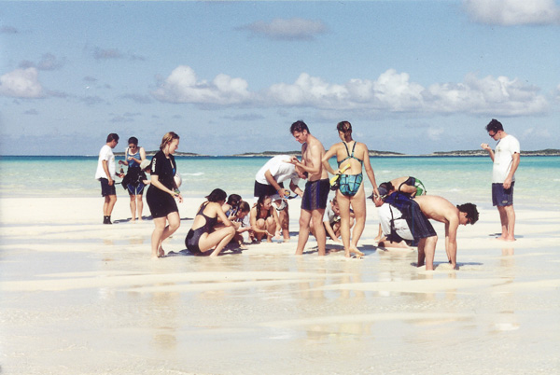
Oolite Appreciation League beach party
But darling, pisolites are forever.
I like ‘em small and round.
Ooh! Oolites!
Oh my god this feels good!
Notes:
Like pisolites, oolites form in back reef environments where the warm water drives dissolved carbon dioxide from solution, reducing acidity and promoting the inorganic precipitation of calcium carbonate. Wave action rolls sand grains around …

Slide 24
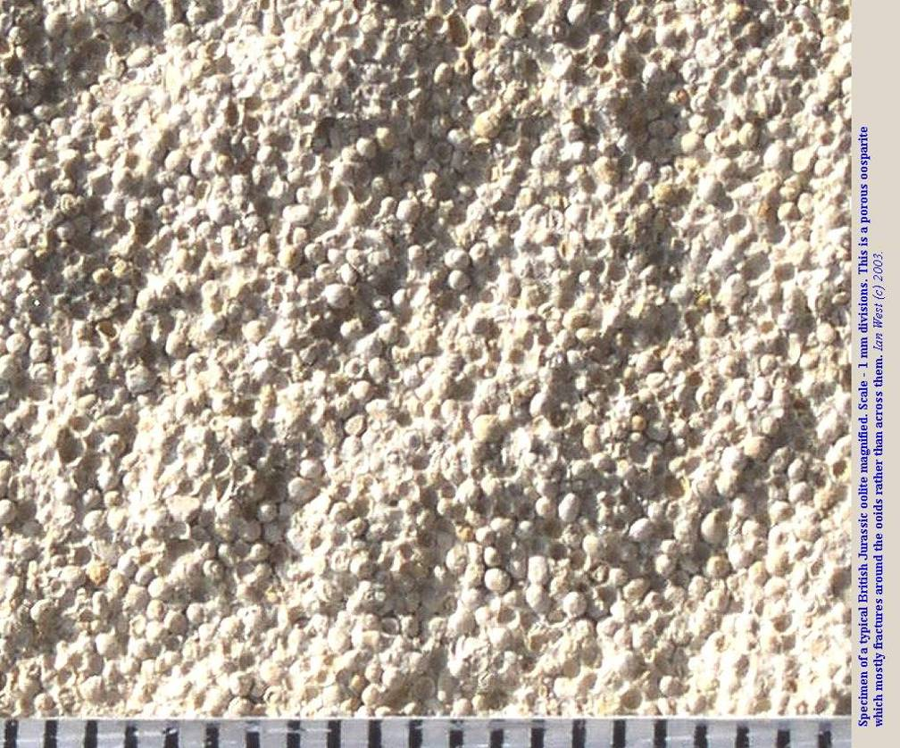
Notes:
… so that an even coating of calcium carbonate shapes each grain into BB-sized spheres.

Slide 25
Notes:
In calmer parts of the back reef the Miami Limestone is represented by a bryozoan facies.

Slide 26
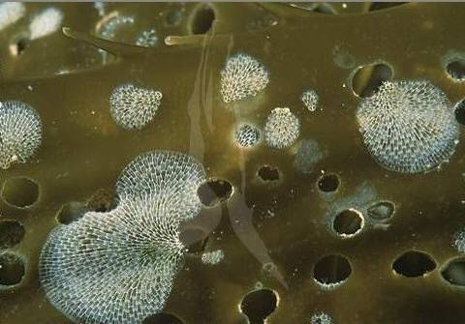
Bryozoan colonies
Notes:
Bryozoans usually form smaller and more delicate colonies than do corals. You may have seen them growing on kelp.

Slide 27
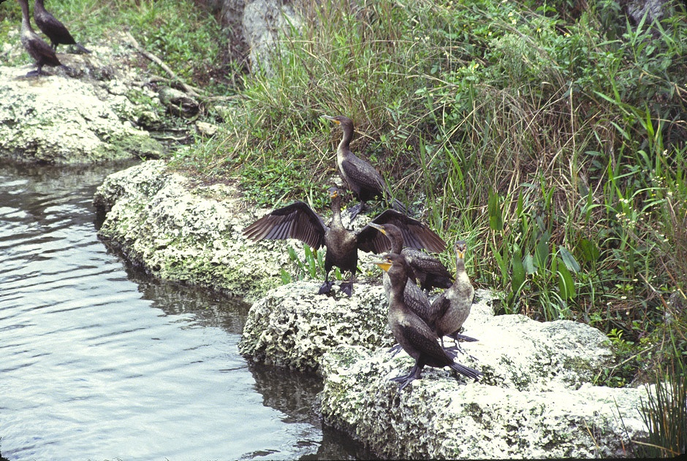
Miami Limestone (bryozoan facies)
Notes:
The bryozoan facies is highly porous and permeable …

Slide 28
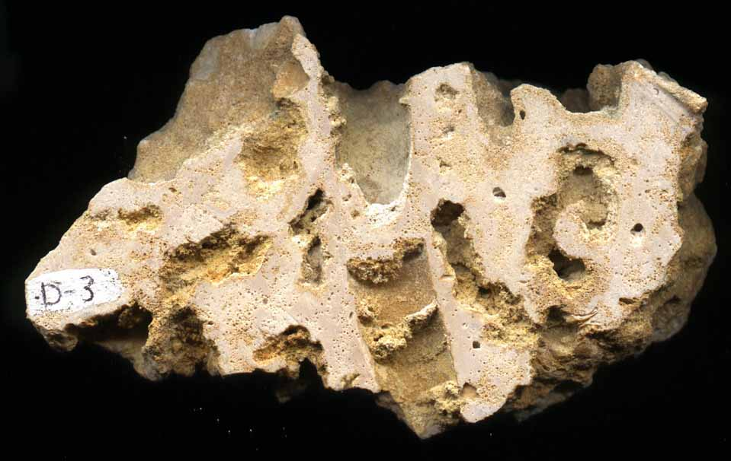
Miami Limestone (bryozoan facies) with solution pitting
Notes:
… which after deposition allowed groundwater to flow through it and cause extensive solution pitting.

Slide 29
Pleistocene (Wisconsinan) erosion:
Sea level dropped more than 300’
Limestone solution
High porosity, sinkholes
Notes:
Most of that pitting took place about 20,000 years ago during the Wisconsinan glacial period when sea level dropped more than 300 feet.

Slide 30
Notes:
That exposed the entire carbonate platform to carbonic acid-bearing rain, …

Slide 31
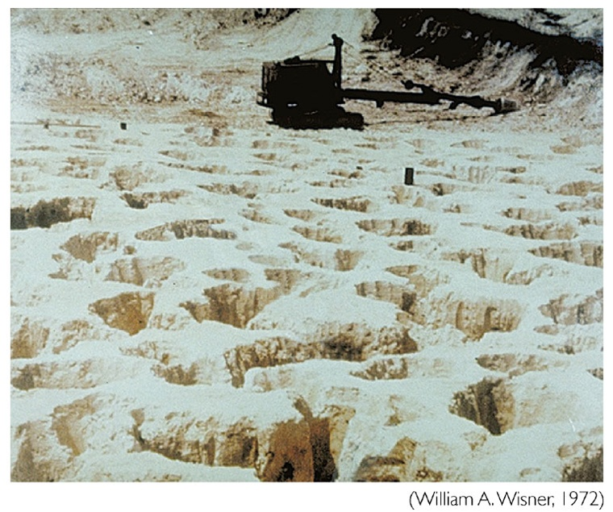
Notes:
… which as can be seen in this Florida quarry, just dissolved the dickens out of the limestone such that much of the state is underlain by a veritable limestone honeycomb.

Slide 32
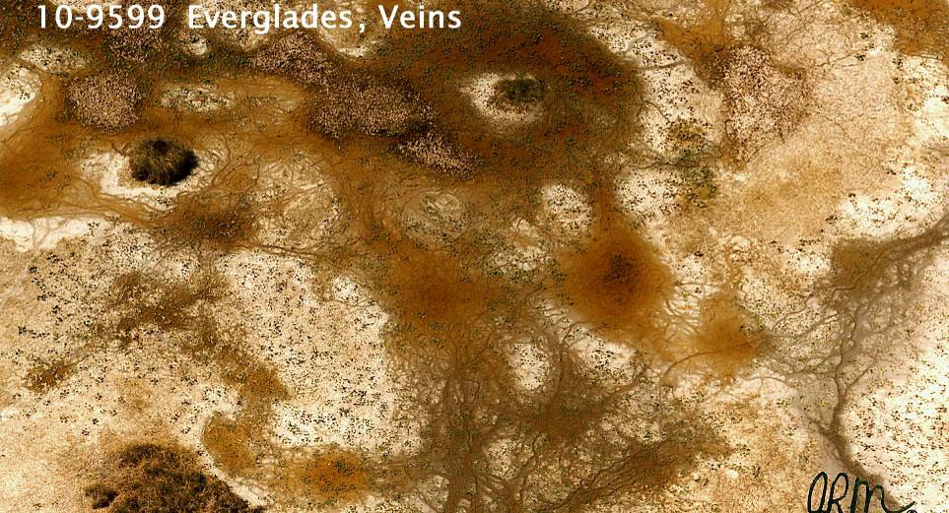
Notes:
During drought years when the water table is very low, the solution cavities are clearly visible in the Everglades as are numerous vein-like channels where the limestone has been dissolved by water flowing across the surface.

Slide 33
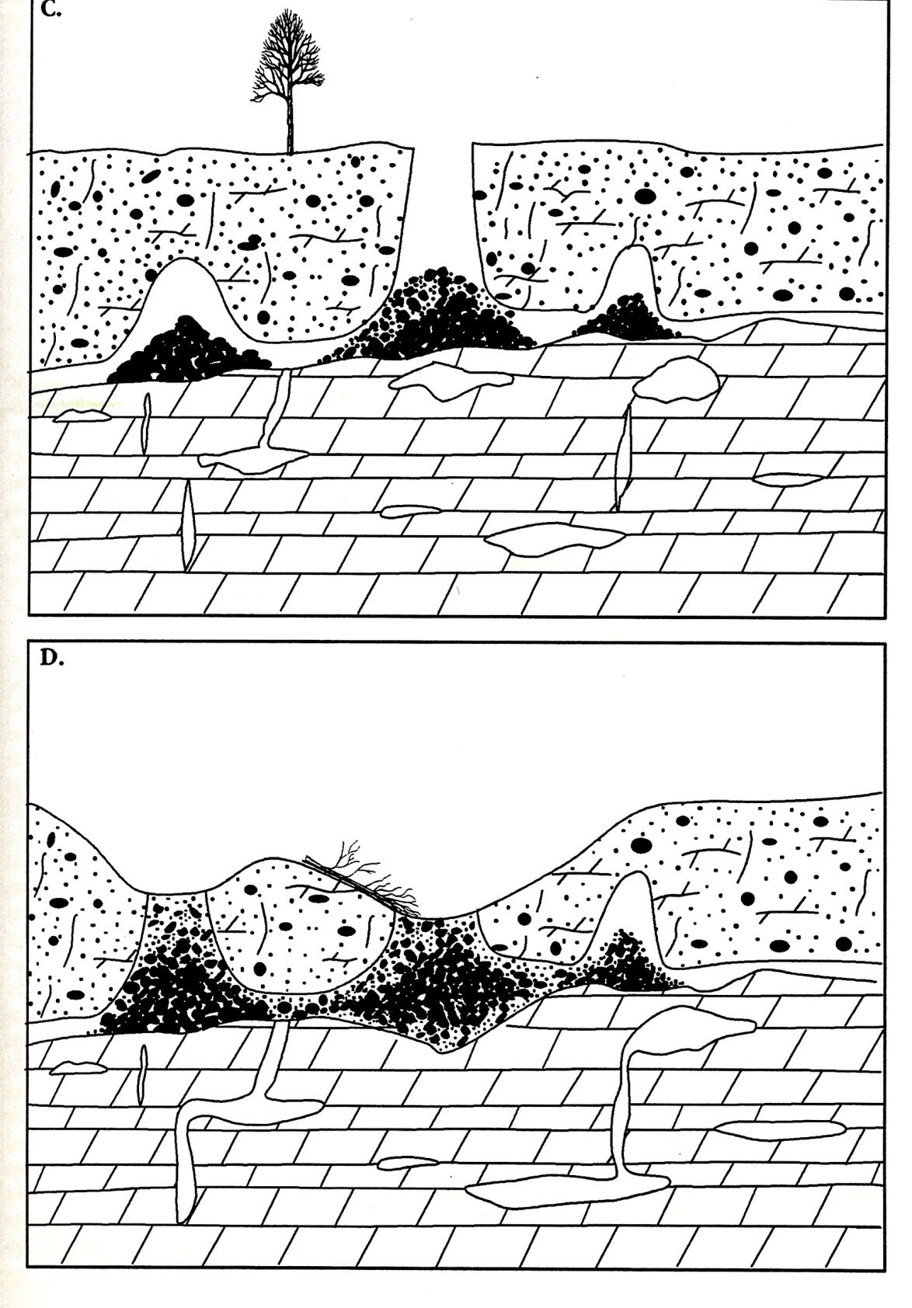
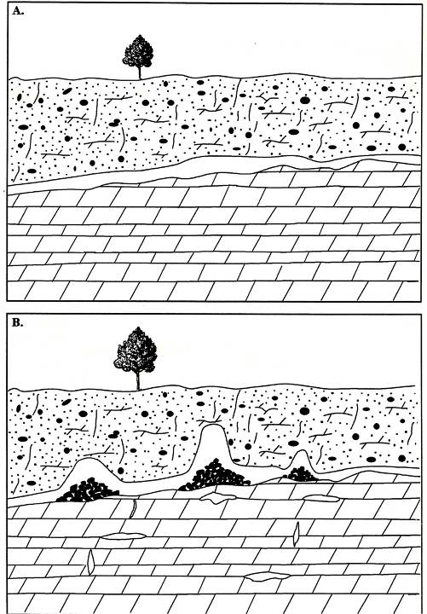
sinkhole
Notes:
Beneath the surface there are abundant caverns dissolved in the limestone. As these enlarge and/or the water table drops, their roofs become unstable and many eventually collapse forming sinkholes. Erosion of the sinkhole’s sides broadens and eventually fills-in the sinkhole.

Slide 34
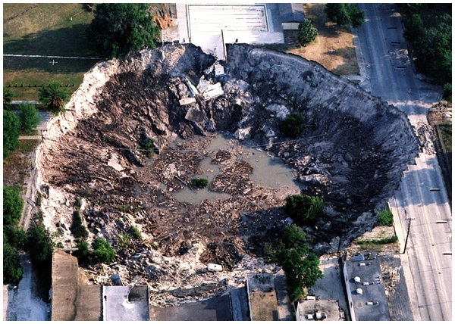
Notes:
Sinkhole formation is common in Florida, especially during drought years when the water table is lower.

Slide 35
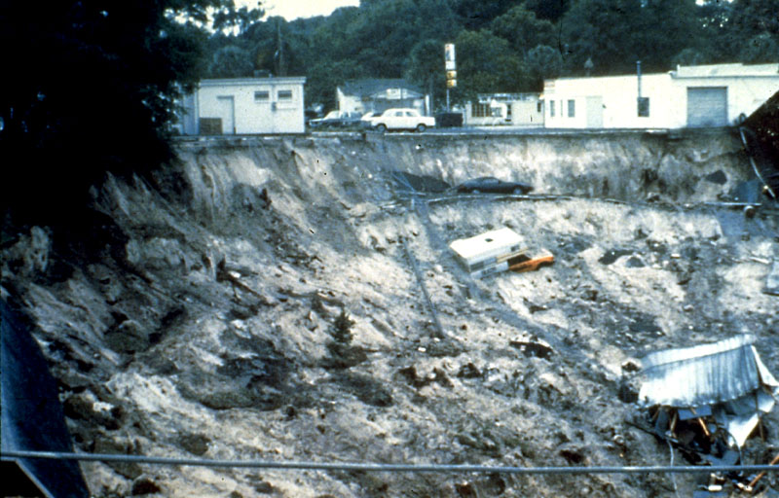
Notes:
Sinkhole formation is critical to understanding the geologic processes that have shaped southern Florida’s national parks …

Slide 36
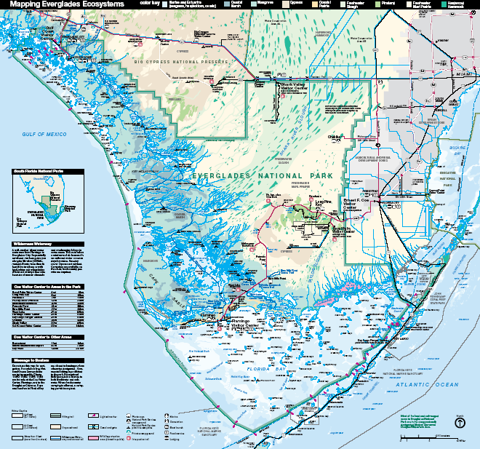
Notes:
… especially the features of Florida Bay …

Slide 37
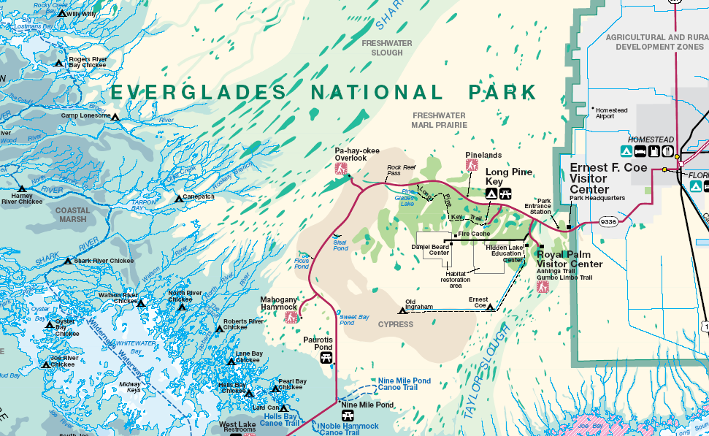
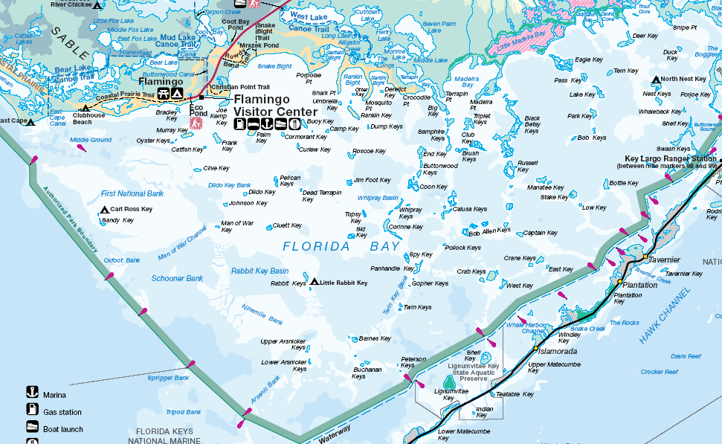
Notes:
… where a chaotic lacework of islands and shoals formed around channels and sinkholes that were mostly eroded some 20,000 years ago when this area was exposed by low sea level.

Slide 38
Holocene deposition (5,000 years – present)
Active reef formation
outer reef
back (patch) reefs
inshore shoals
Notes:
The rise in sea level following the Wisconsinan ice age had three main depositional consequences. First and foremost is active reef formation, where three important depositional environments developed – the outer reef, the back or patch reefs and the inshore shoals.

Slide 39
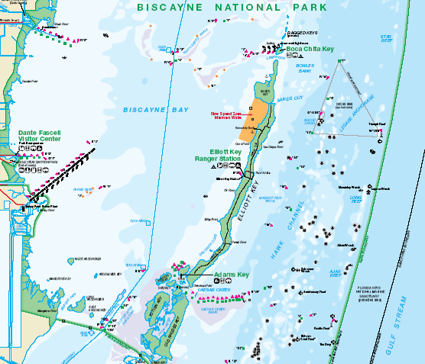
Outer reef
Notes:
The outer reef is located several miles seaward of the keys.

Slide 40
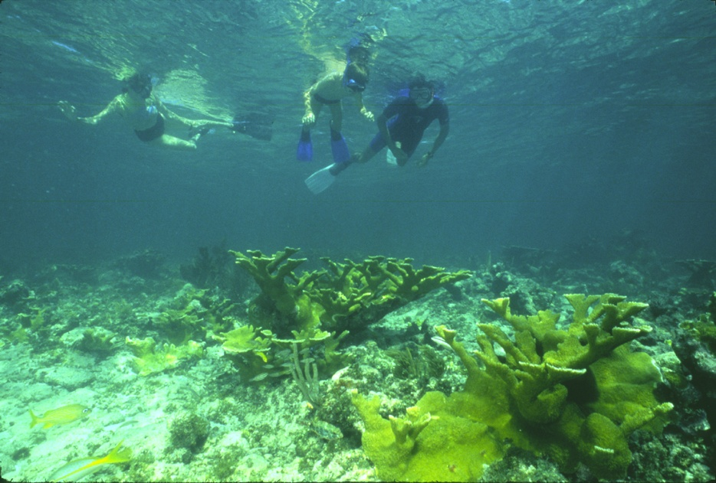
Elkhorn coral on outer reef
Notes:
It is on the outer reef where the water is clearest and therefore sunlight penetration greatest. These are the ideal conditions for Elkhorn coral.

Slide 41
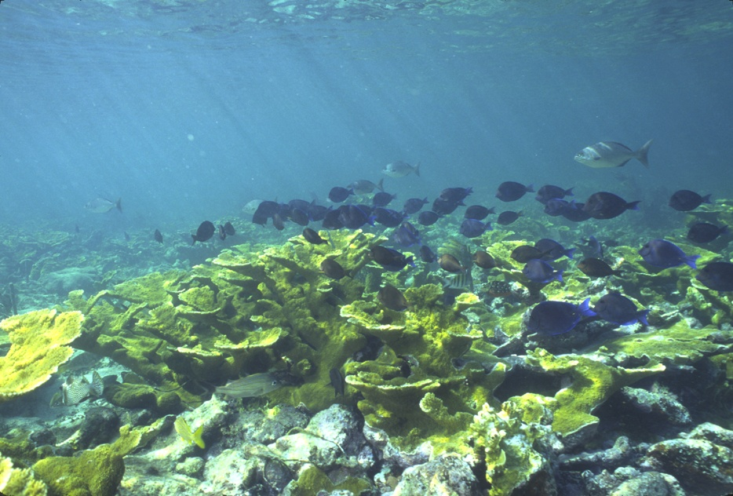
Elkhorn coral grows fast, shading reef
Notes:
The rapid and shelf-like growth of Elkhorn Coral shades the outer reef, inhibiting the growth of other species.

Slide 42
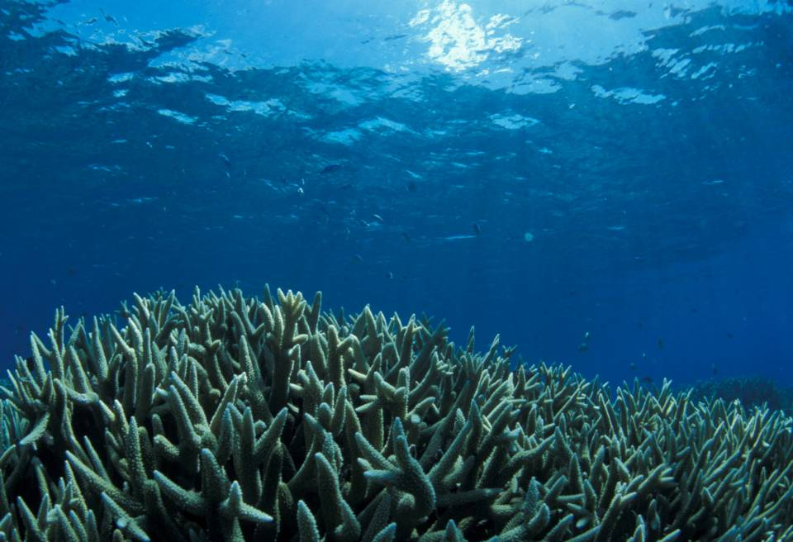
Staghorn coral grows in water below 10m
Notes:
In deeper parts of the outer reef, where sunlight is not sufficient to support Elkhorn coral, species like Staghorn coral can gain a foothold.

Slide 43
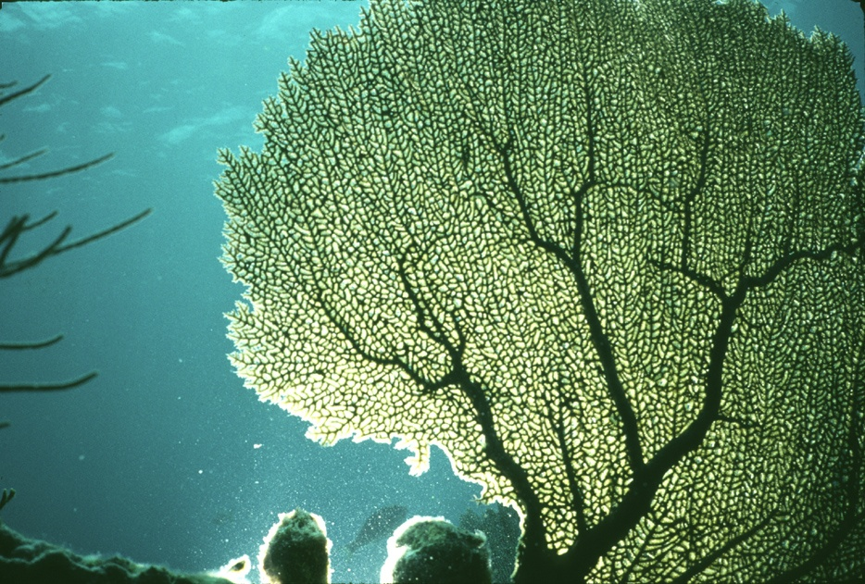
Sea Fan in deeper offshore water
Notes:
And in the deepest levels of the photic zone, where the water is calmest, fragile sea fans grow.

Slide 44
Patch reefs
Notes:
Patch reefs grow between the outer reef and the keys.

Slide 45
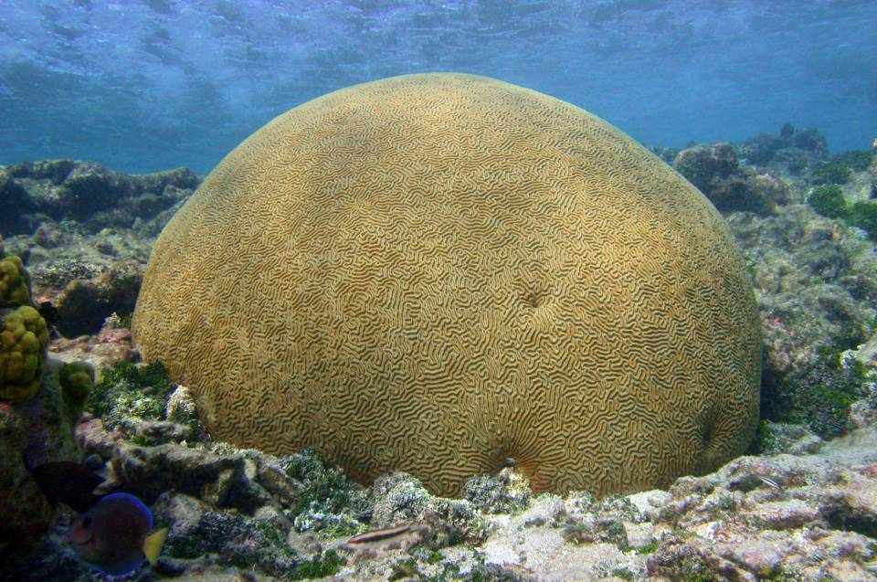
Patch reef brain coral
Notes:
Typical patch reef builders include brain coral …

Slide 46
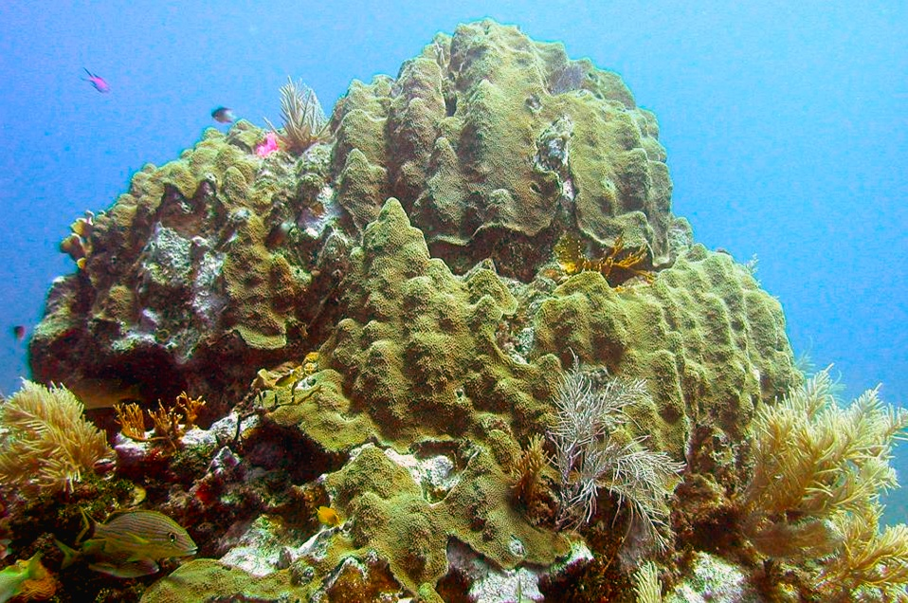
Patch reef star coral
Notes:
… and star coral.

Slide 47
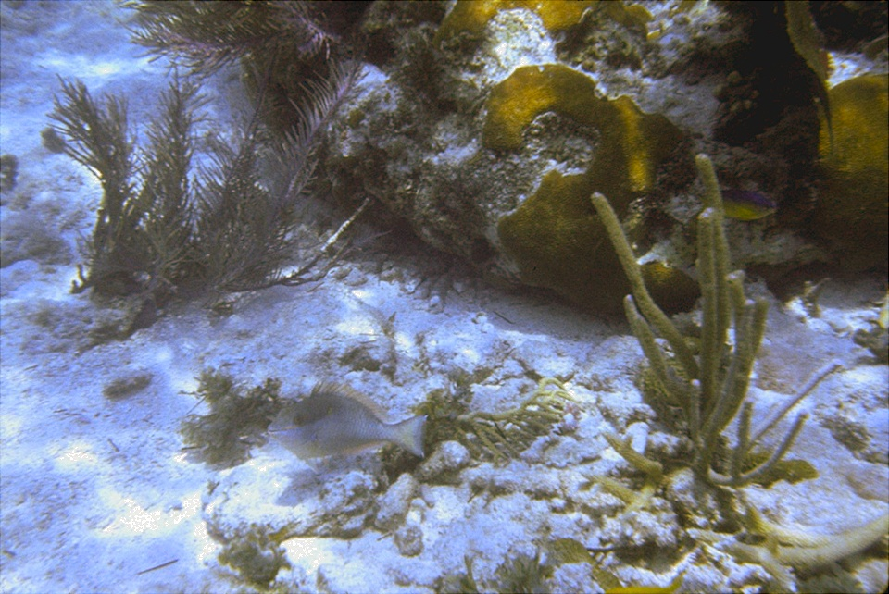
Seabed of chewed-up coral
Notes:
Because several fish species eat coral, the back reef seabed becomes littered with chewed-up coral skeletal fragments.

Slide 48
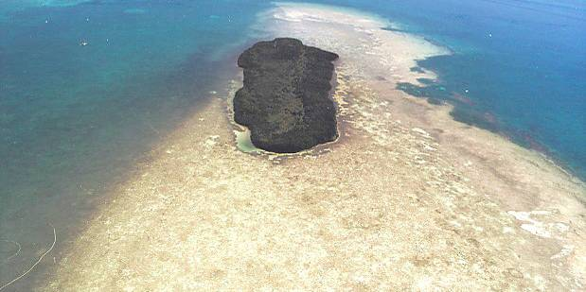
Rodrigez Key (inshore shoals)
Notes:
Currents transport the coral sand and sweep it into shoals, …

Slide 49
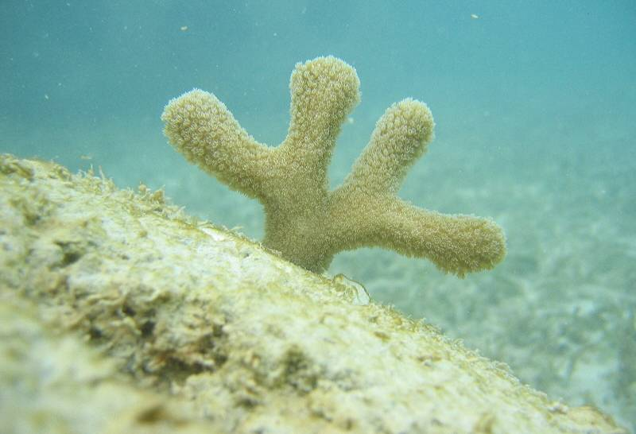
Finger coral on inshore shoal
Notes:
… where about the only coral that can grow is the sediment and salinity tolerant finger coral.

Slide 50
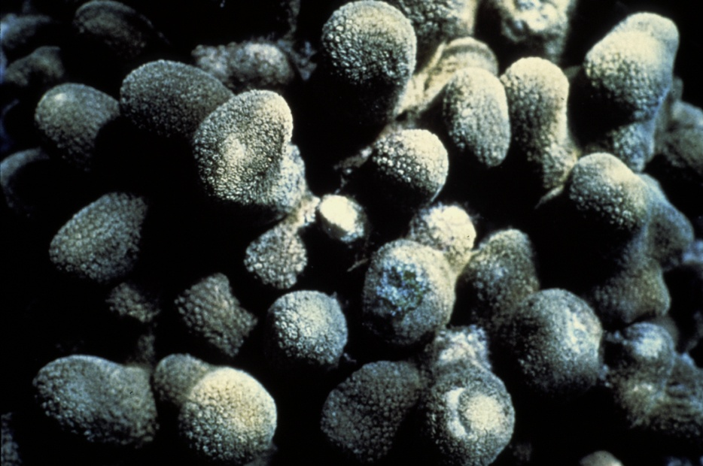
Finger coral colony
Notes:
Inshore shoals can become covered with finger coral colonies.

Slide 51
Relict patch reefs
Notes:
Apparently the upper keys are patch reef relicts from the high sea level periods of 120,000 years ago …

Slide 52
Relict shoals
Notes:
… whereas the lower keys are relict shoals from the same period.

Slide 53
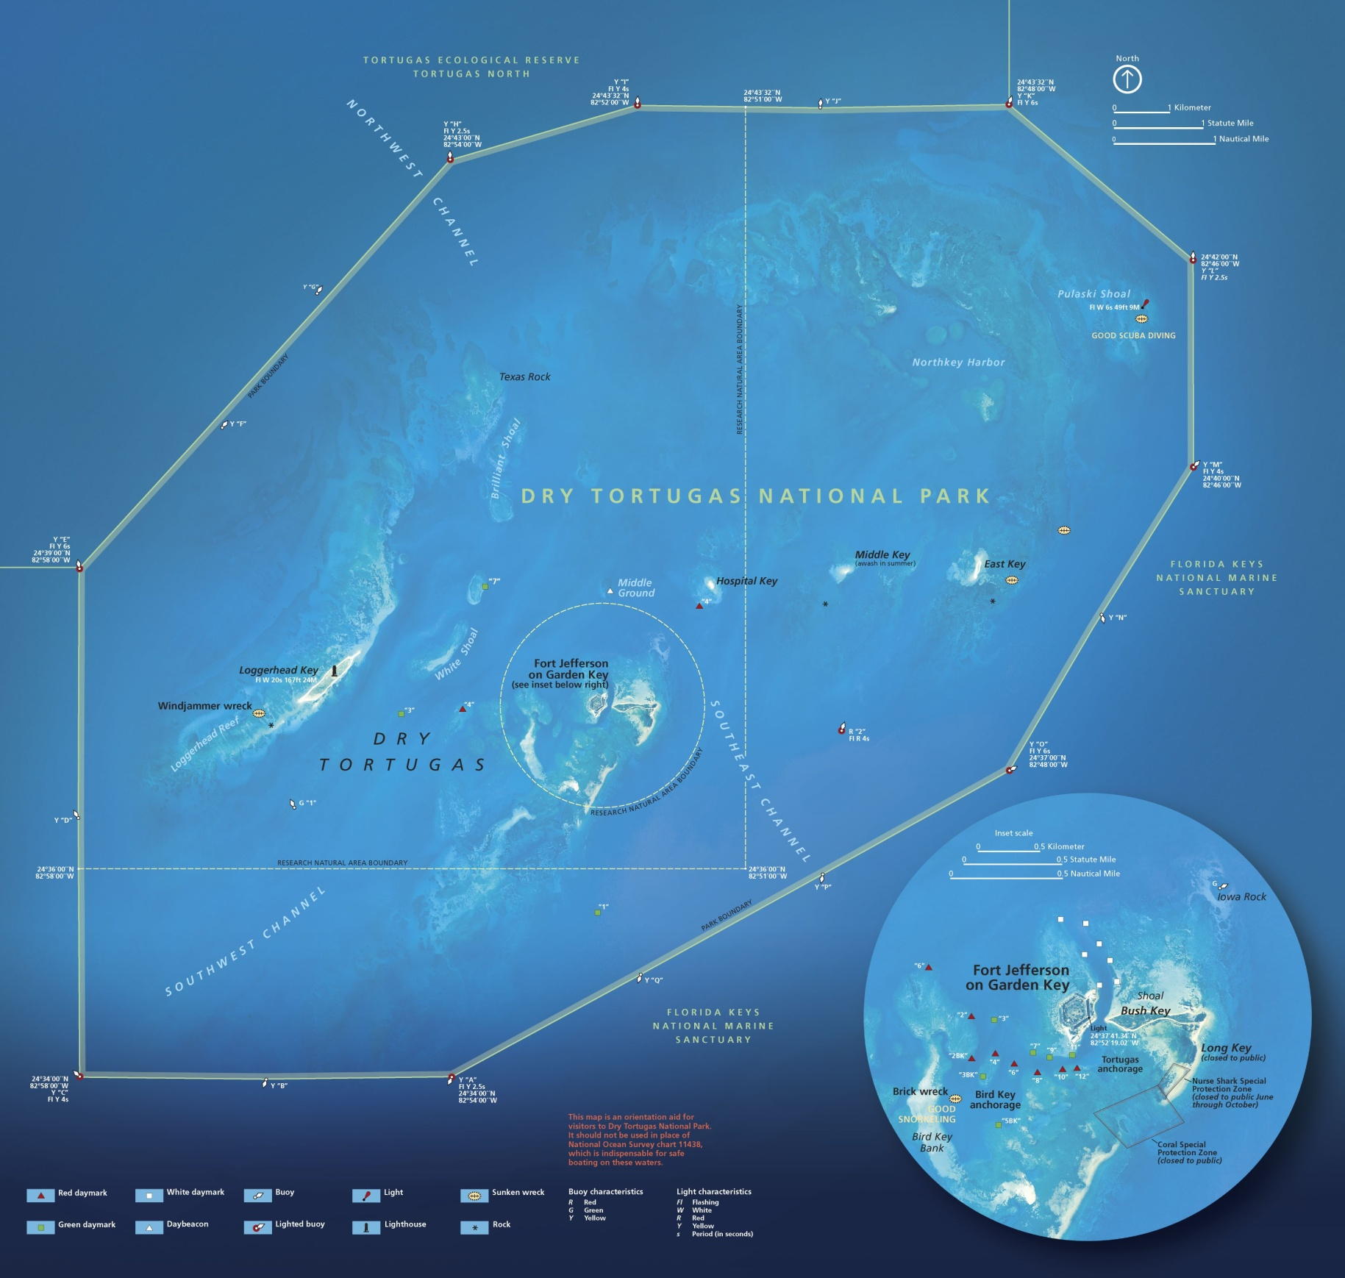
Notes:
Dry Tortugas National Park circumscribes a group of the most westerly of the relict shoals.

Slide 54
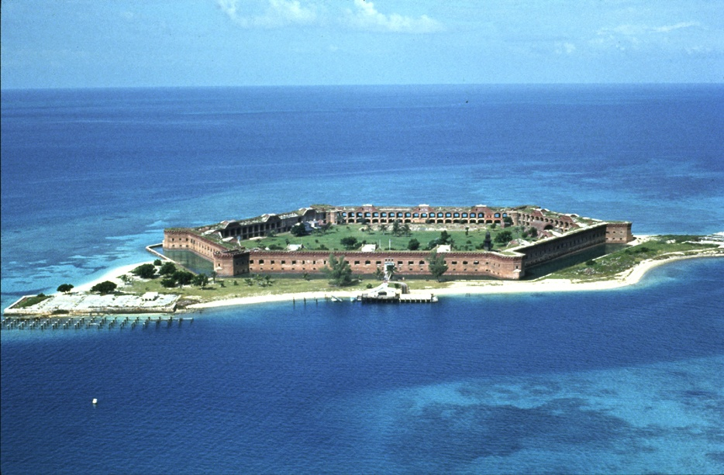
Fort Jefferson, Dry Tortugas N.P.
Notes:
The most notable landmark in the park is Fort Jefferson. Built in the mid-1800’s, initially to guard shipping routes in the Gulf of Mexico, the fort’s primarily use ended-up being as a prison.

Slide 55
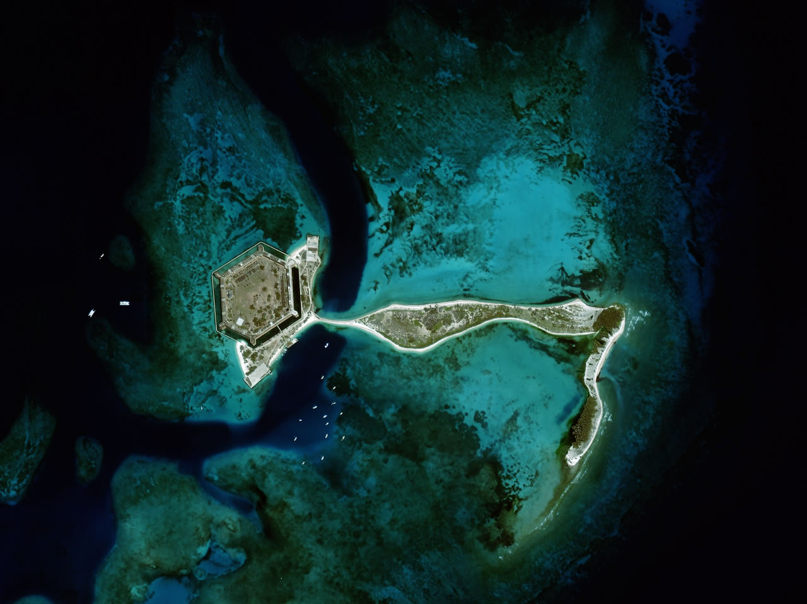
Notes:
But because the fort was built on unconsolidated coral sand, …

Slide 56
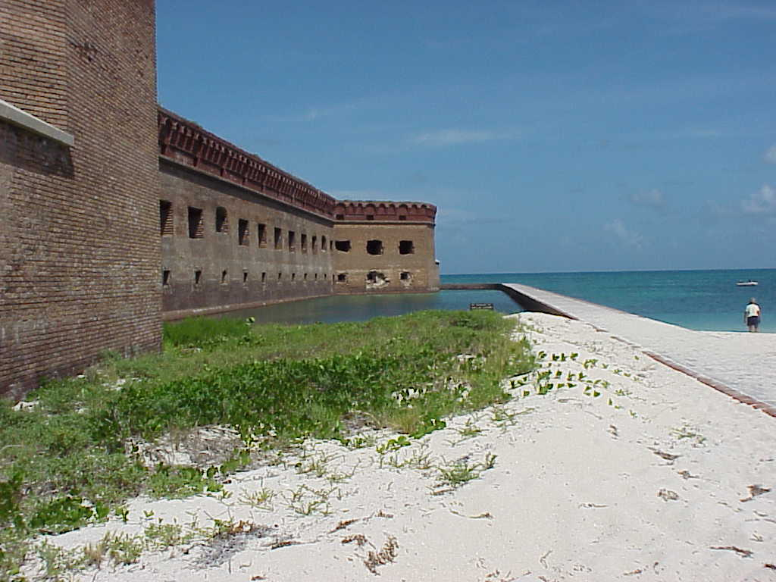
Notes:
… the massive weight of the masonry structure could not be supported and the fort suffered serious cracking shortly after it was built.

